Slide 1
Welcome to foothill highschool
Parenting a high-schooler is not for the weak !

Slide 2
Administration Team
Heather King | Principal
Andrea Villani | Assistant Principal
Dr. Micah SImmons | Deputy principal
Barb Ruth | Activities Director
Bill Lum | Athletic Director

Slide 3
Emergency cards
Students must have a current and completed emergency card on file
Please update your cards whenever there are changes in address and/or phone numbers and/or contacts

Slide 4
Electronic policy
.

Slide 5
Social media
Be aware of what your student places on social media…
They will be held responsible for social media posts that have the possibility of affecting school safety
It is your right to monitor your child’s social media accounts
Recent Media has reported on numerous high schools students having their college scholarships revoked due to social media posts.

Slide 6
deliveries
Food | Food delivery services will not be accepted
Emergency Items | Students will be called to the office
Non-Emergency deliveries | Students may get their deliveries between periods, during lunch, or after school.

Slide 7
lunches
We have 2 lunches
Free Breakfast and lunch
M, Tu, Thur, Friday- Lunch is based on your 4th period class 1st Lunch buildings S, F, T 2nd Lunch buildings PE, C, N, E
Wed - Lunch is based on your 5th period class 1st Lunch = S, F, T 2nd Lunch = PE, C, N, E
* students caught off campus will receive correction consequences

Slide 8
Tardy policy
FHS Truancy and Tardy Policy

Slide 9
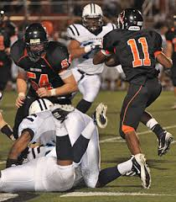
Friday night football…and more
All FHS students must bring their foothill student id to enter
athletic events unless accompanied by their parents.
Students may not attend or participate in any extra curricular event while suspended
Students that need to be removed from a game will lose
this privilege for the duration of that season.

Slide 10
Counseling team
COUNSELOR | ALPHA
MR. BAXTER | A-F
MR. BALDERAS | G-MEH
MS. SABET | MEJ-S
MRS. LUAT | T-Z

Slide 11
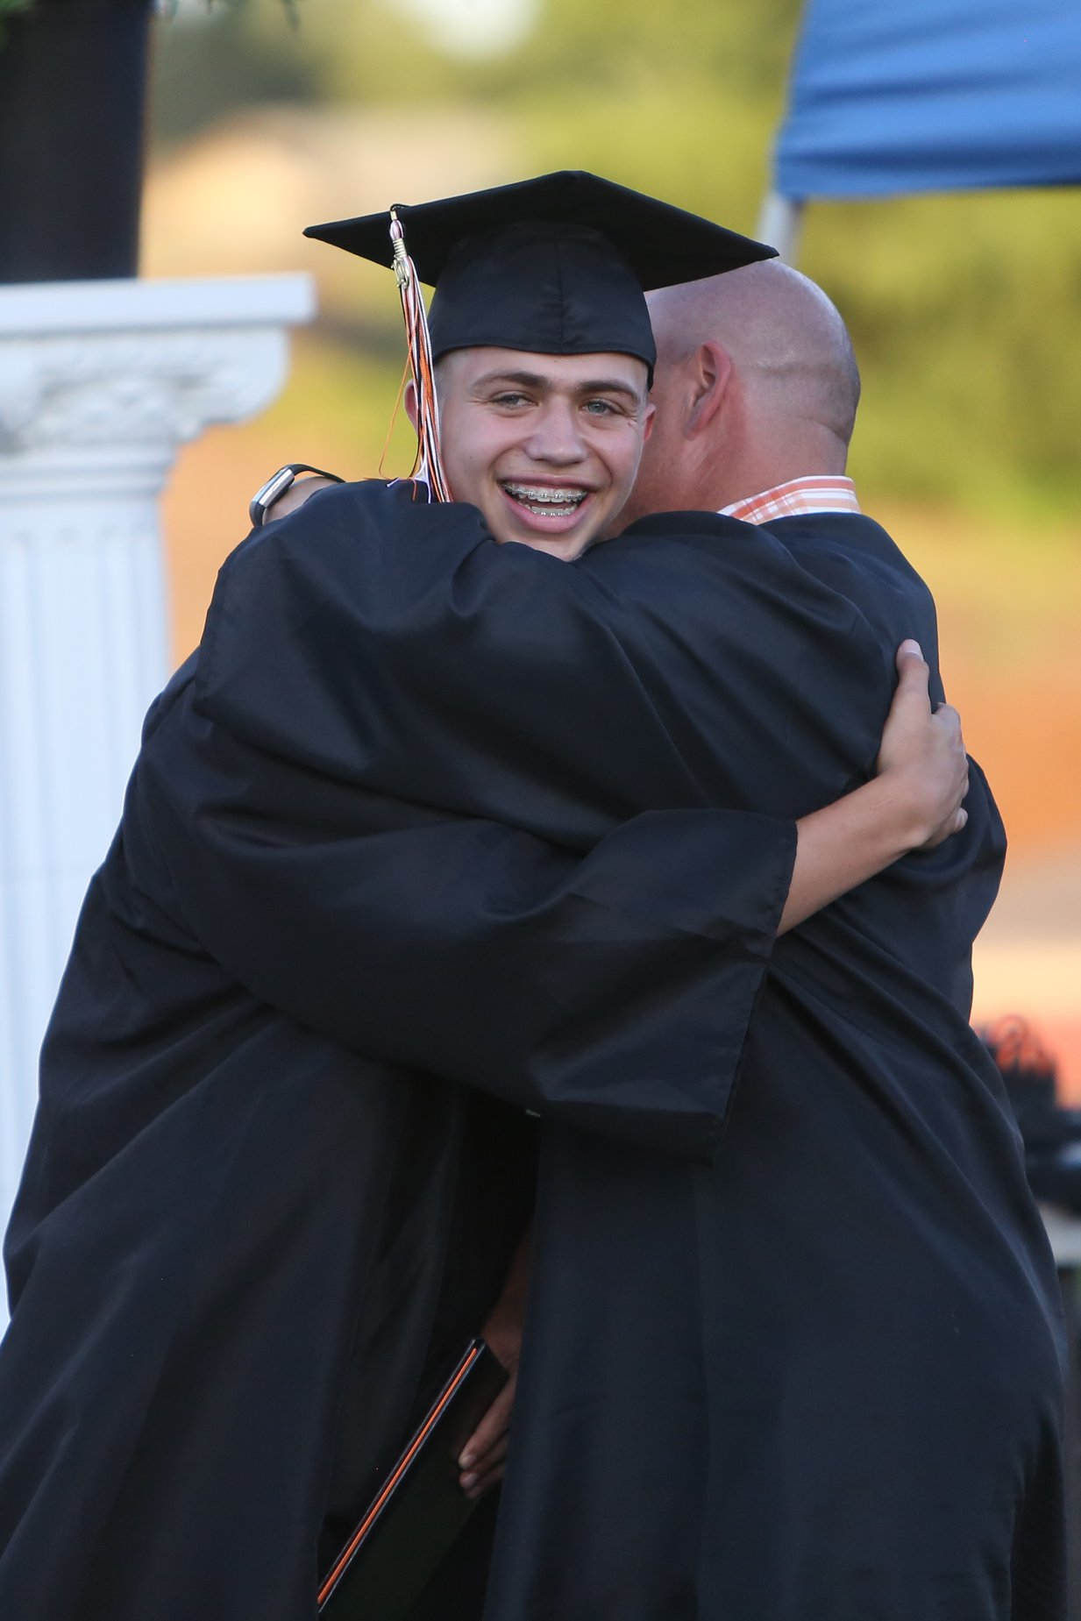
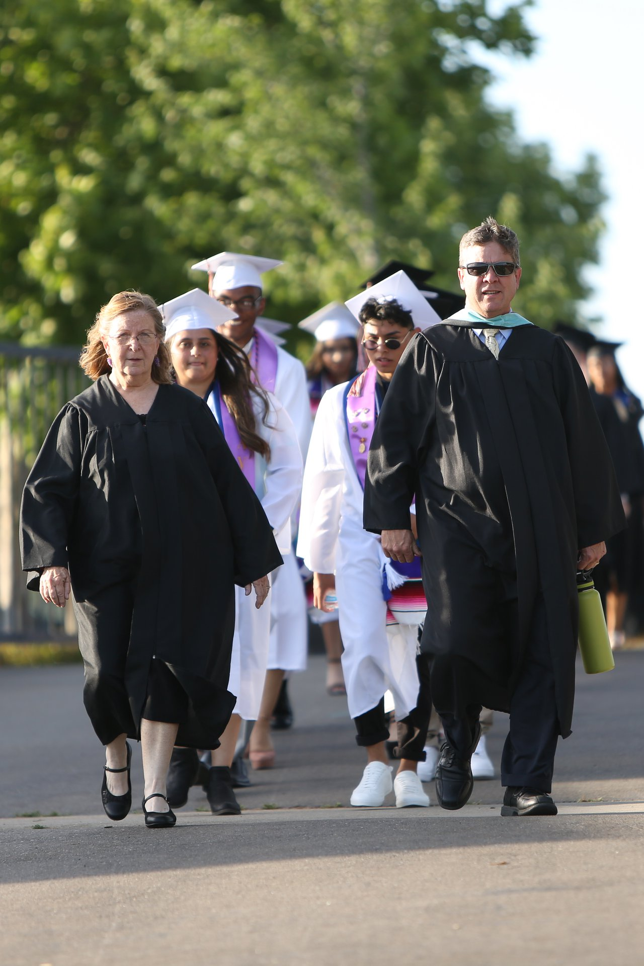
Graduation Requirement
30 credits of Social Science
40 credits of English
30 credits of Math (Math 1 required to graduate)
20 credits of Science (Life & Physical)
10 credits Visual/Performing Arts or Foreign Language
20 credits Physical Education
65 credits of Electives
5 credits of health
TOTAL: 220 CREDITS

Slide 12
Freshman pe … how to pass
Highest failure rate for freshman is p e
There are Ten points possible per day
Dressing for PE is worth 50% of each day’s points
Students must change into athletic clothes that are white, orange, grey, or black. Students may purchase PE clothes at the student store if desired. The cost of the shirt and shorts is $20.00 ( or $10.00 a piece ).

Slide 13
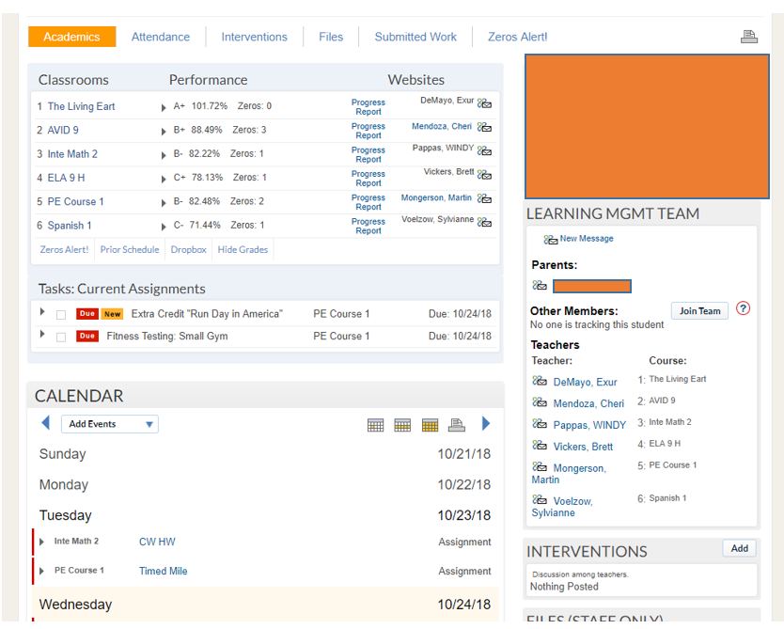
School loop
Please utilize school loop everyday to…;
Check grades
Current assignments
Upcoming due dates
Attendance and tardies
Messages from staff
To contact teacher

Slide 14
The importance of attendance and being on time
By 6th grade, chronic absence becomes a leading indicator that a student will drop out of high school.
Research shows that missing 10 percent of the school, or about 18 days in most school districts, negatively affects a student’s academic performance. two days a month of absences equals chronic absence. (SARB/SART)
Research shows that attendance is a better indicator than iq for high school graduation

Slide 15
Get engaged
Fall | Winter | Spring
Football | Boys and Girls Basketball | Track and field
Girls Volleyball | Boys and Girls Soccer | Boys volleyball
Boys and Girls Cross Country | Boys and Girls Wrestling | Baseball
 |  | Softball
 |  | Swimming
Clubs
Avid | Pre-Med
Book Club | Pride Club
BSU | Project Positivity
Friday Night Live | Swim Team Club
Game Club | Unified Peer Buddies

Slide 16
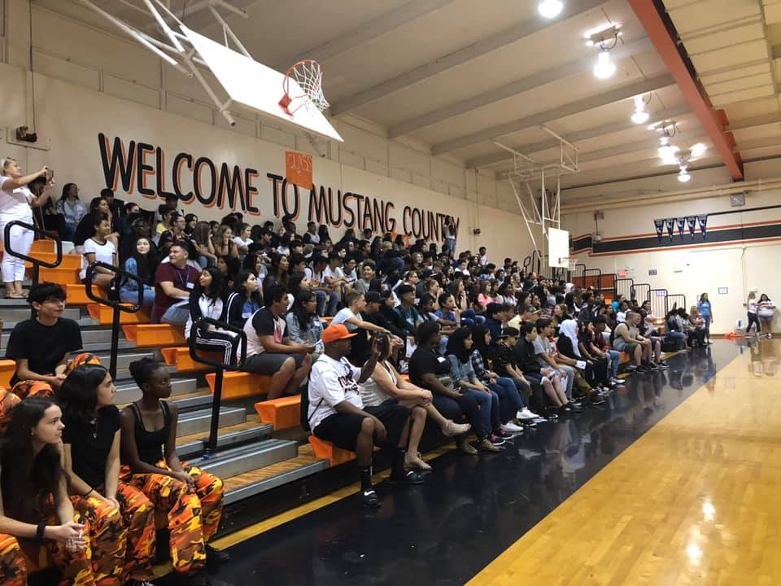
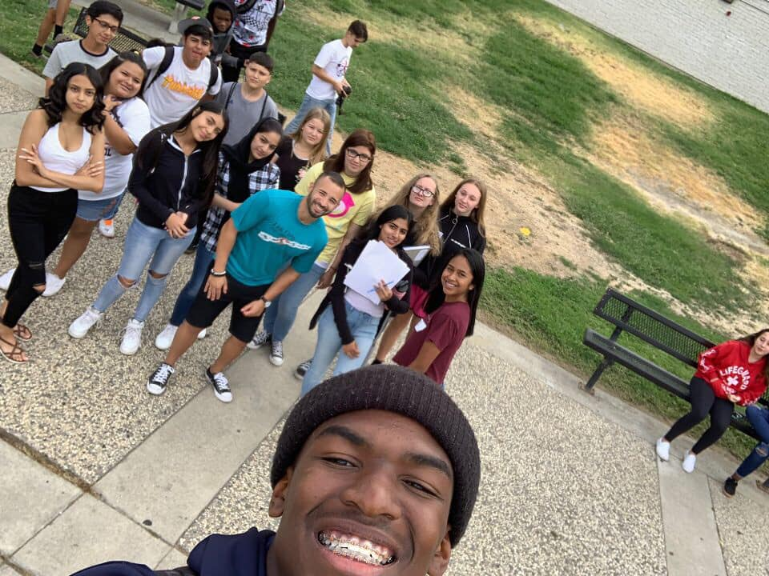
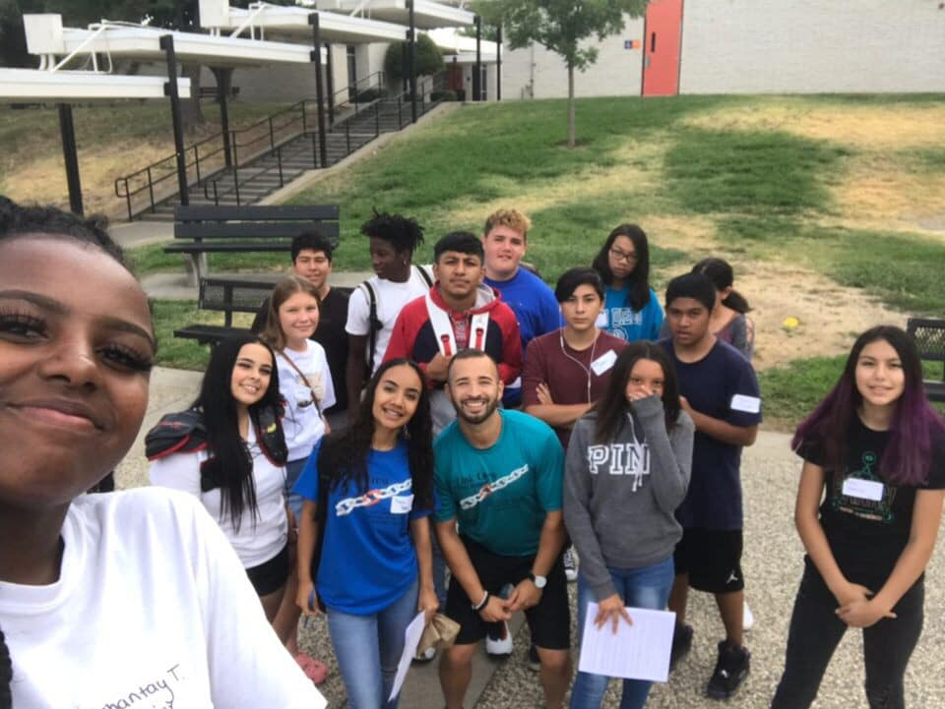
Link crew
Designed to assist Freshman in the process of transitioning into high school.
Designated upperclassman to each freshman.
Mentoring and bonding opportunities.
Aimed and ensuring each student at FHS feels included.

Slide 17
Stay involved
Attend games
Attend back to school night 8/28/19
Attend open house 4/23/2020
Attend concerts
Stay in communication with the teachers and other support staff

Slide 18
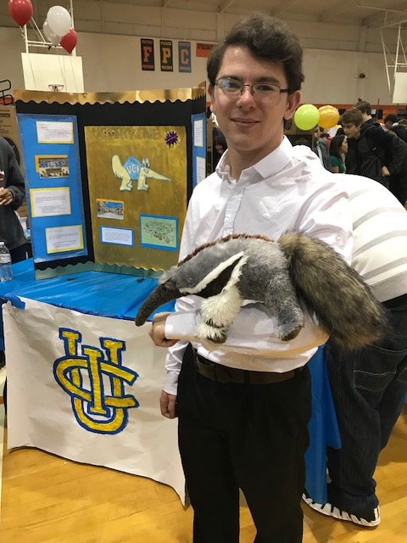
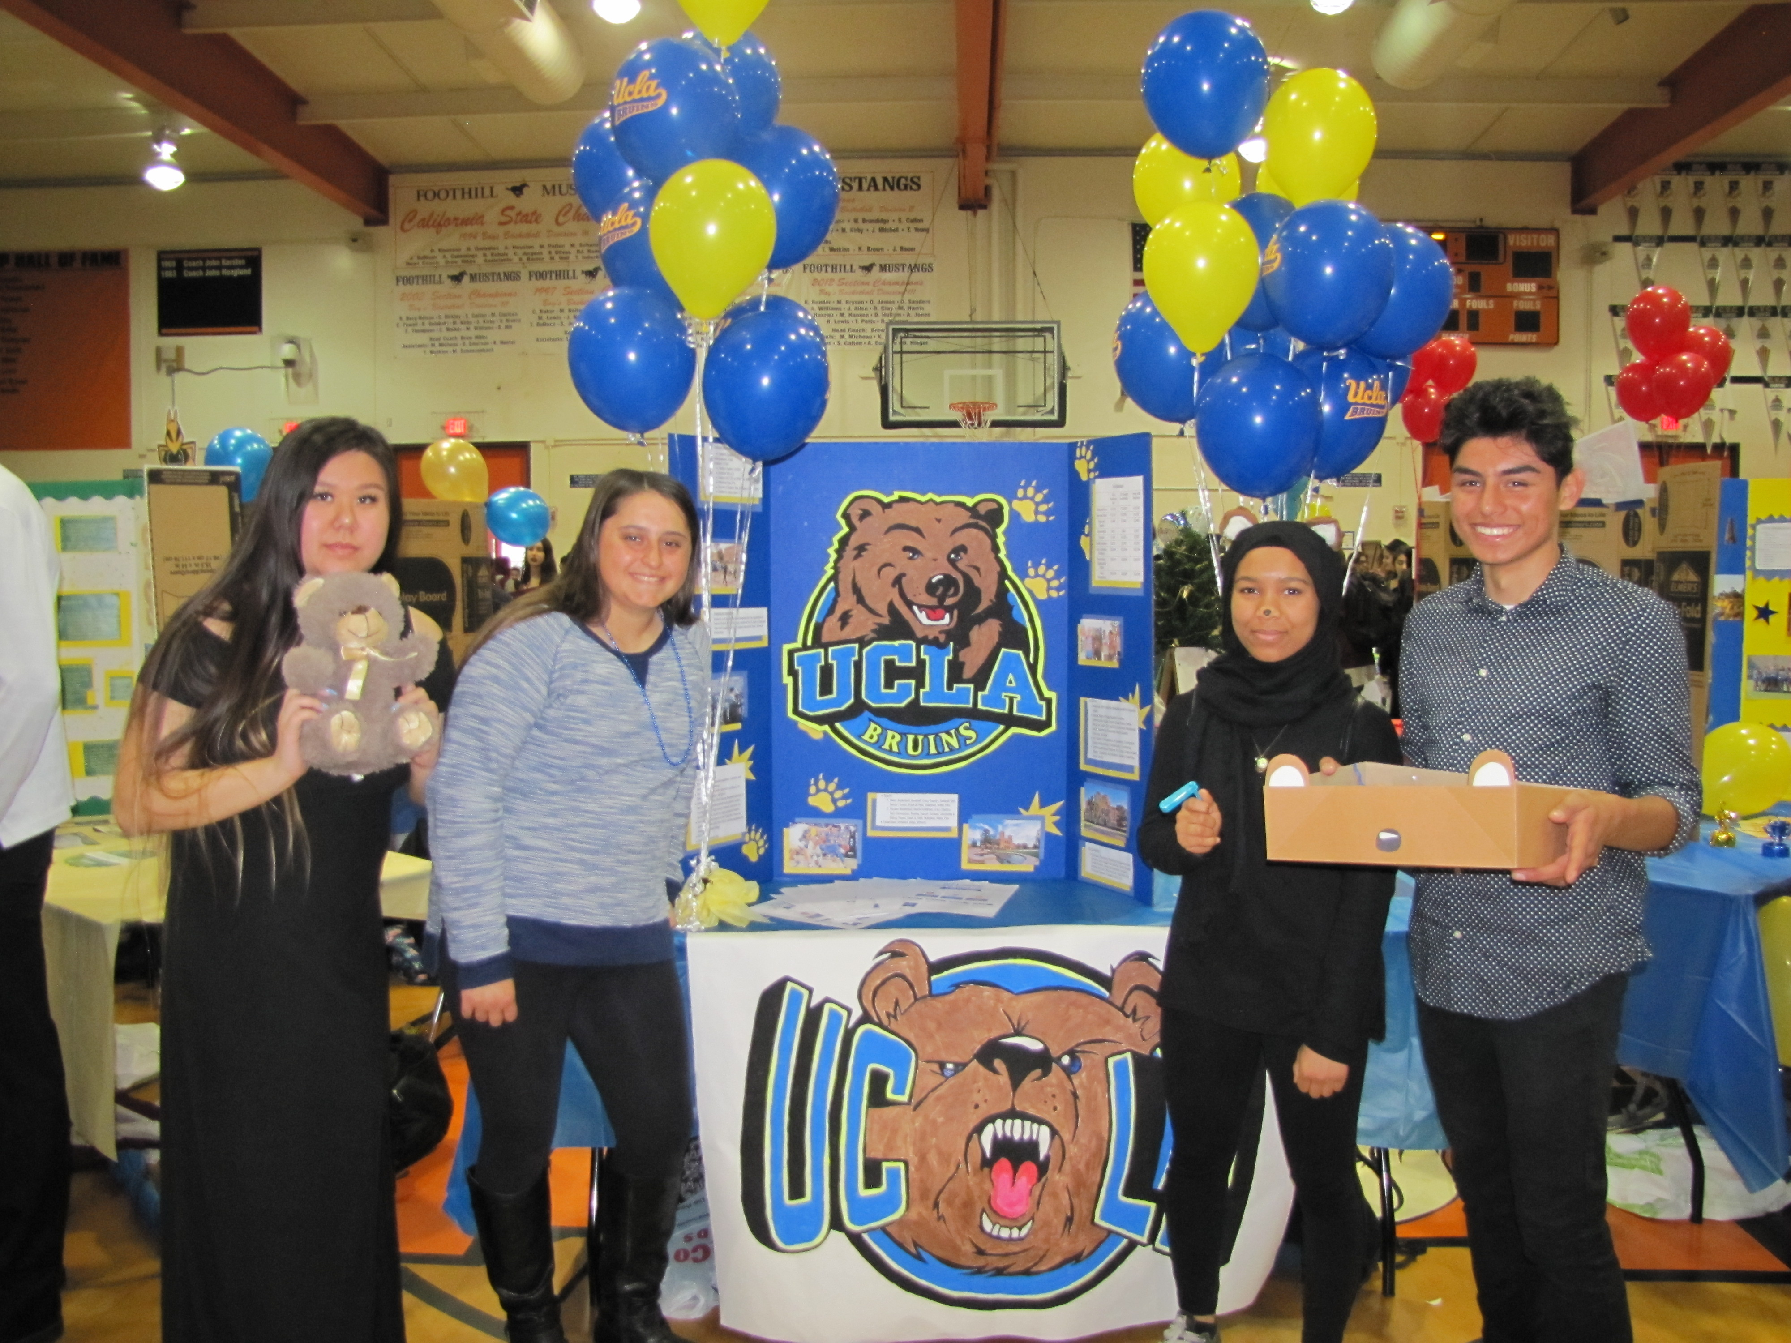
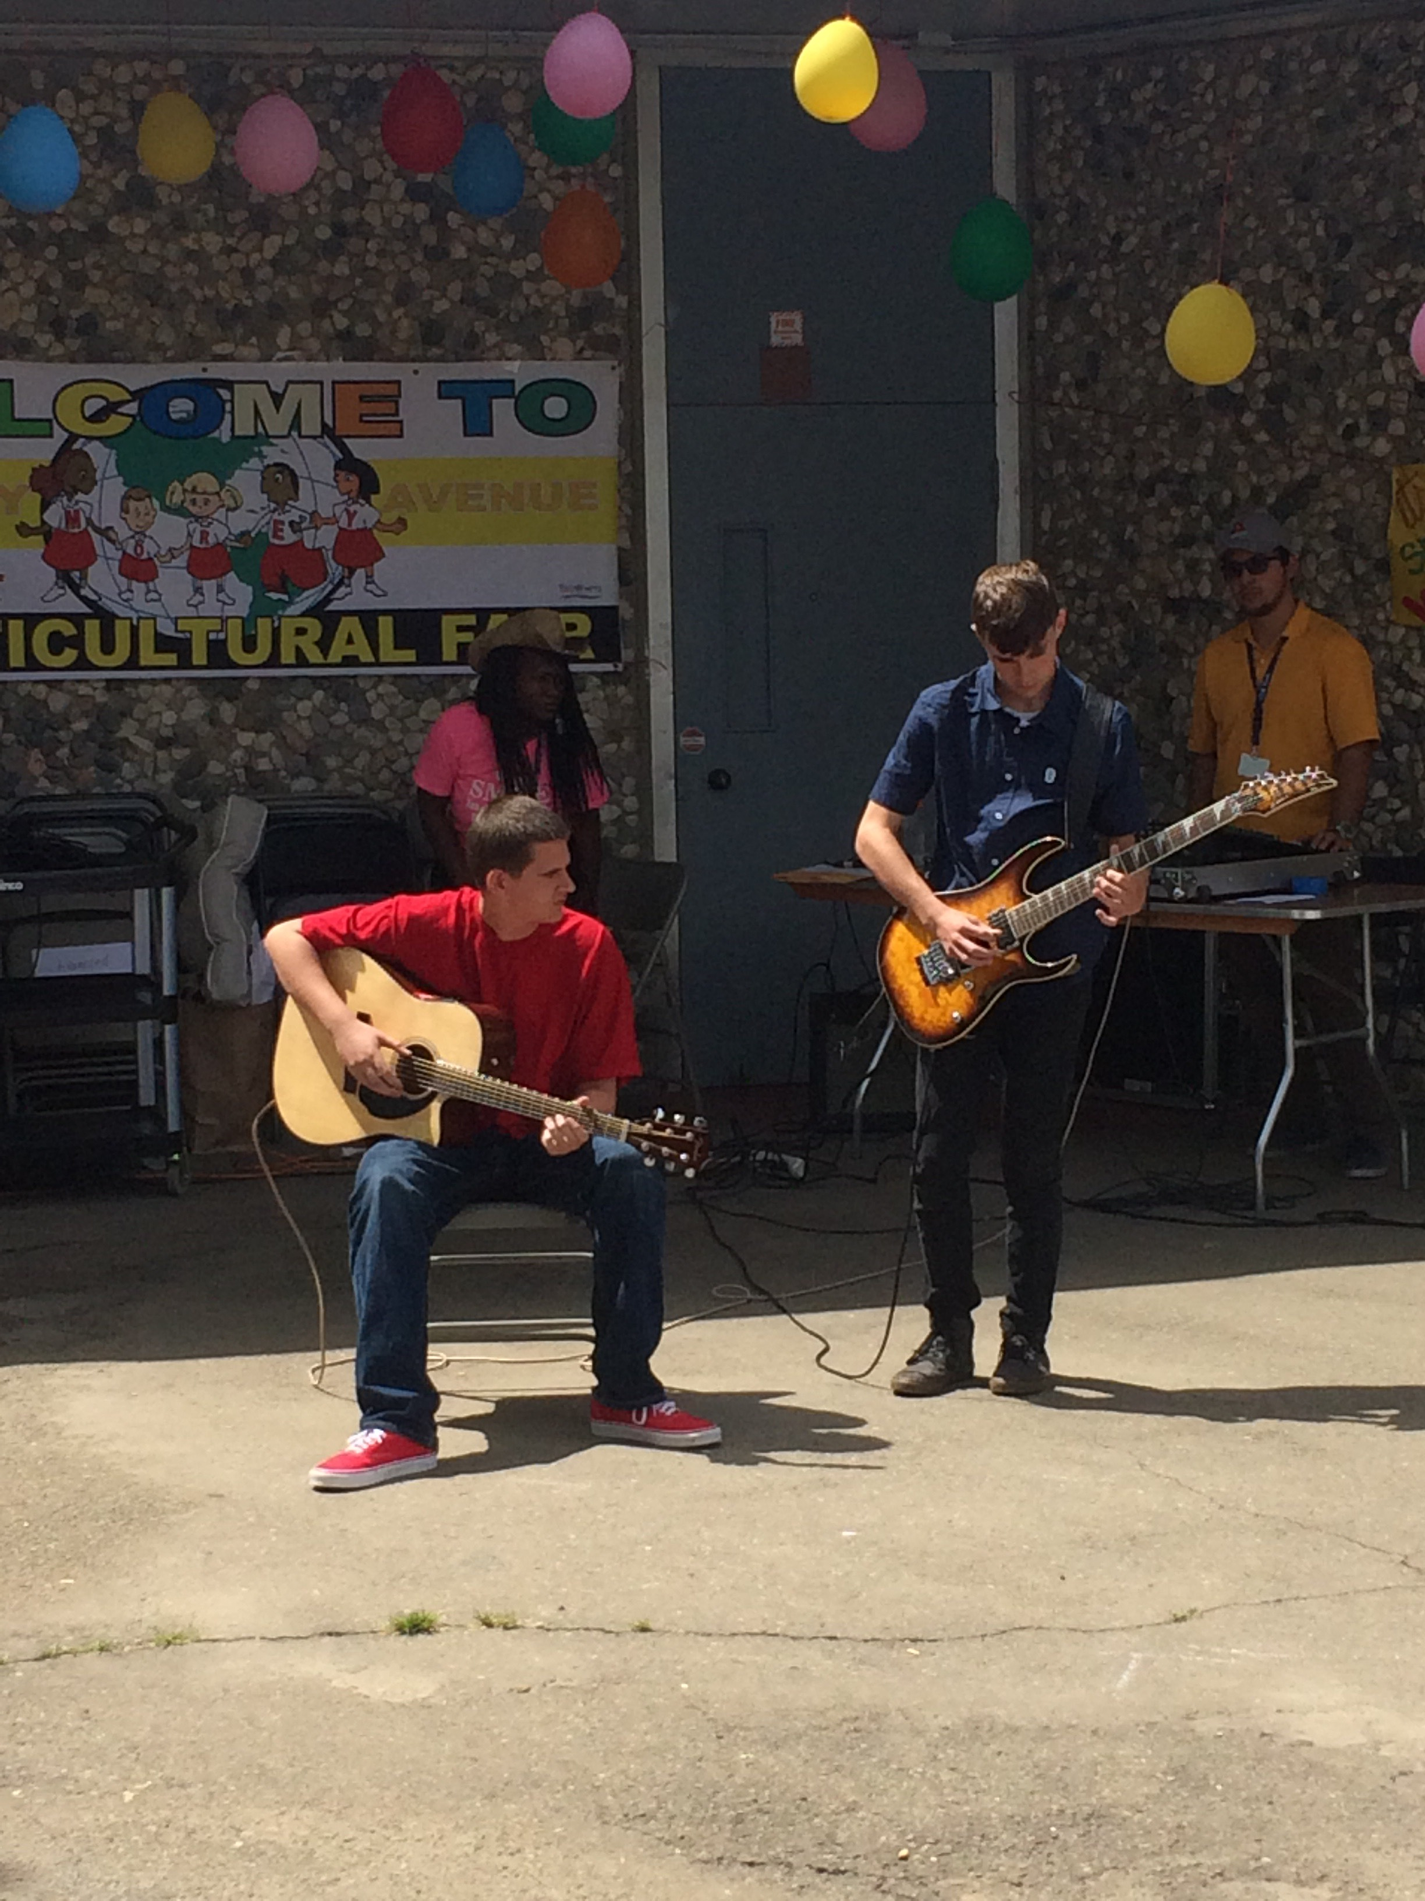
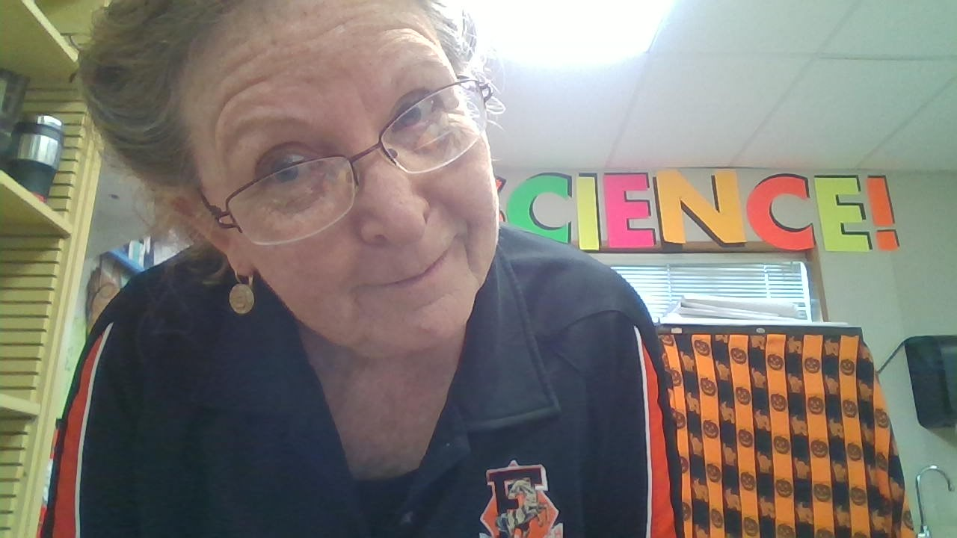
Welcome to the foothill family

